Slide 1
Introduction (PART 2)

Slide 2
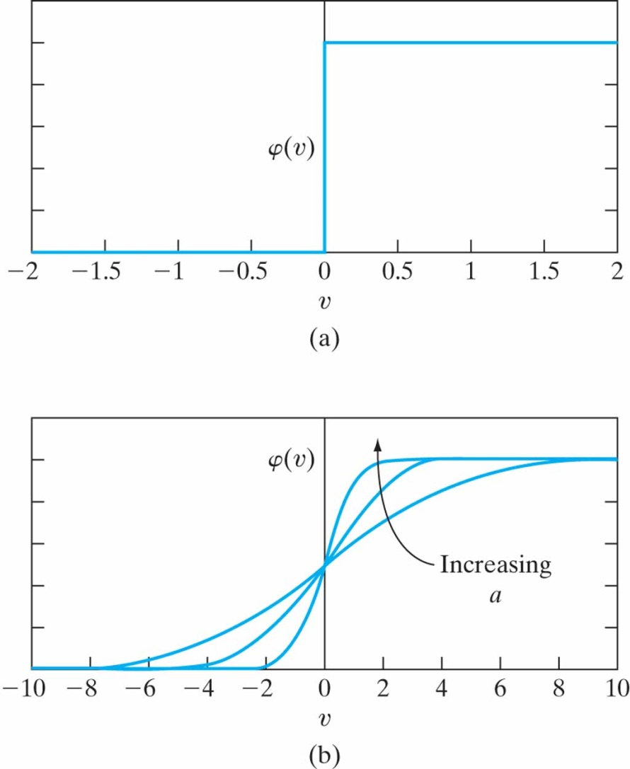
Types of Activation Function
The activation function (φ(v)) defines the output of a neuron in terms of the activation potential v_{k}
3 basic types are
Threshold function (top right)
Piecewise linear function
Sigmoid function (bottom right) - most common

Slide 3

Types of Activation Function
Sigmoid function
is the slope parameter
This function is differentiable (important as we will describe in Chapter 4)

Slide 4
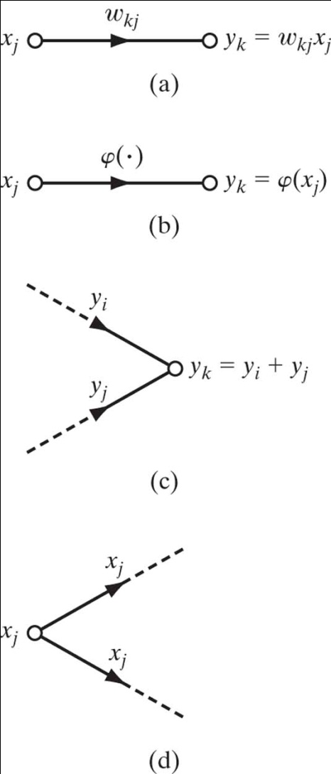
ANNs as Directed Graphs
Simpler graphs can be drawn which are similar to signal-flow graphs
A signal-flow graph is a network of directed links that are connected at nodes
Signal only flows in the direction of the arrows
Synaptic links (a) and activation links (b)
A node signal is the sum of all signals entering
Node signal is transmitted to all outgoing links

Slide 5
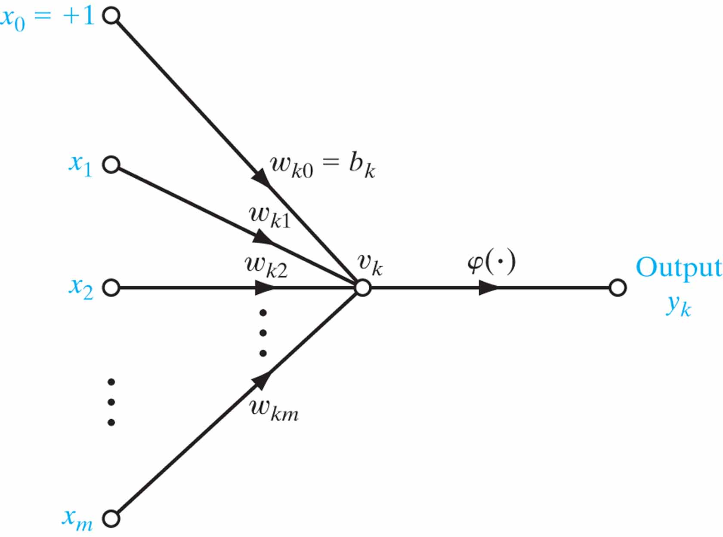
Figure 10 Signal-flow graph of a neuron.

Slide 6
ANNs as Directed Graphs
An ANN is a directed graph consisting of nodes with interconnecting synaptic and activation links, and is characterized by four properties:
Each neuron is represented by a set of linear synaptic links, an externally applied bias, and a possibly nonlinear activation link. The bias is represented by a synaptic link connected to an input fixed at +1.
The synaptic links of a neuron weight their respective input signals .
The weighted sum of the input signals defines the activation potential of the neuron in question.
The activation link squashes the activation potential of the neuron to produce an output.

Slide 7
ANNs as Directed Graphs
When we are interested in signal flow from neuron to neuron and not the details of individual neurons, we can use a partially complete graph as follows:
Source nodes supply input signals to the graph.
Each neuron is represented by a single computation node.
Links connecting source and computation nodes carry no weight; they only show flow direction

Slide 8
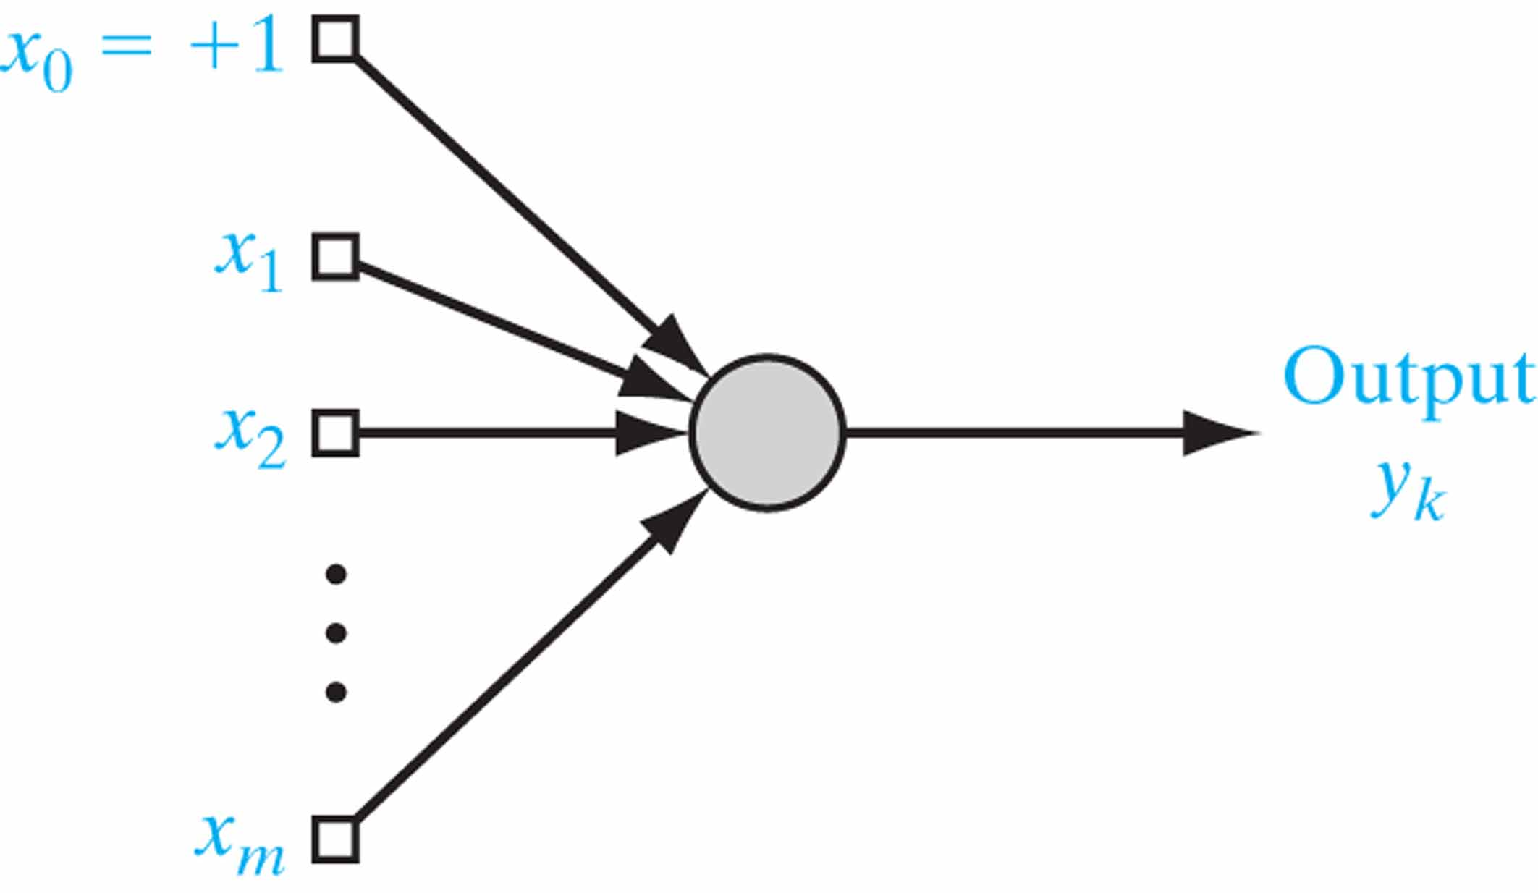
Figure 11 Architectural graph of a neuron.

Slide 9
ANNs as Directed Graphs
In summary, there are 3 graphical representations that we use
Block diagram
Signal-flow graph
Architectural graph

Slide 10
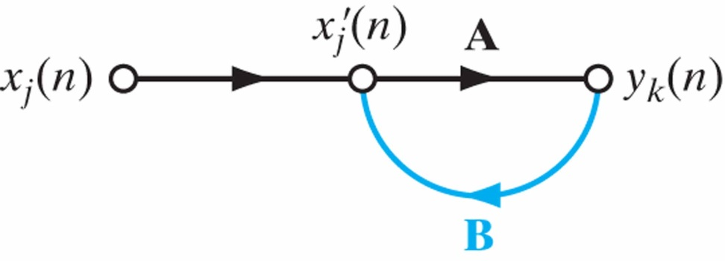
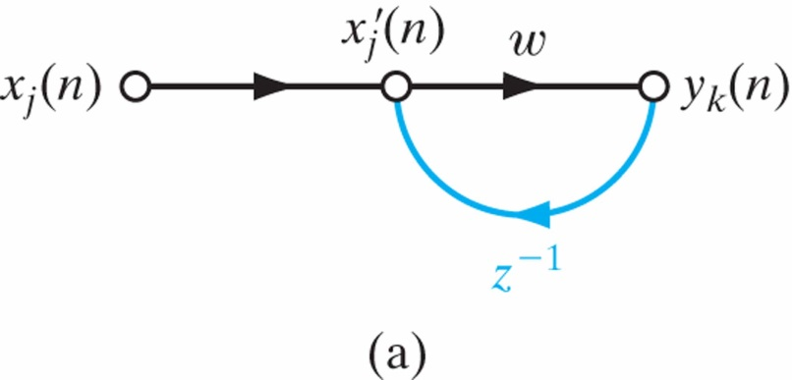
Feedback
Feedback exists in a system when the output of an element influences in part the input to that element (resulting in closed paths and what we call recurrent networks)
A, B can be replaced with valid operators such as a weight w or unit-delay operator z⁻¹

Slide 11
Network Architectures
The structure of an ANN affects which learning algorithm to use (learning algorithms may be structured)
There are 3 fundamentally different network architecture classes in general:
Single-Layer Feedforward Networks
Multilayer FeedForward Networks
Recurrent Networks

Slide 12
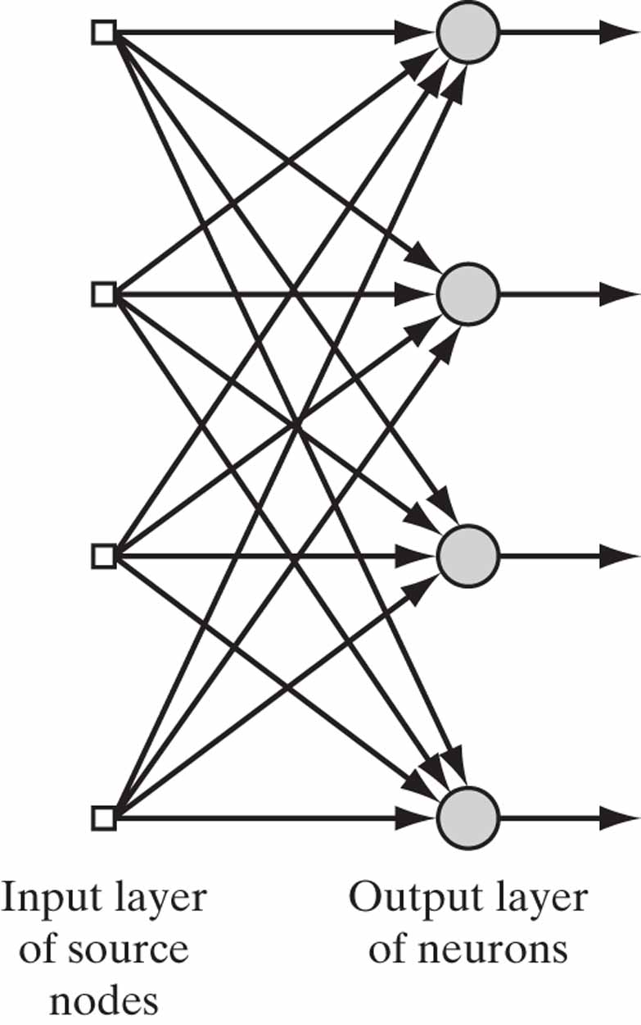
Single-Layer Feedforward Networks
An input layer of source nodes projects onto an output layer of neurons
No feedback at any point (therefore feedforward)

Slide 13
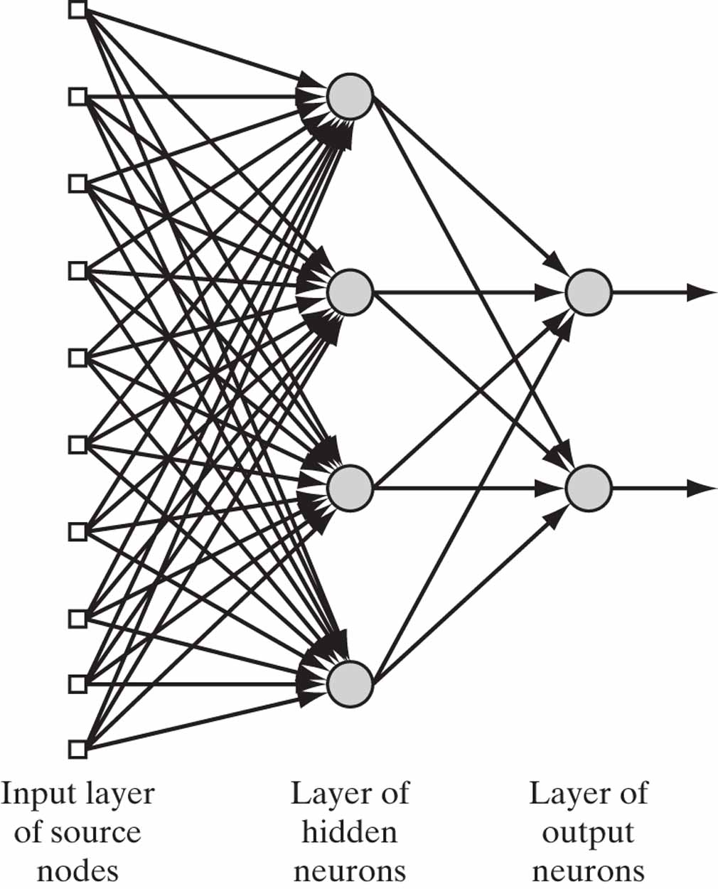
Multilayer Feedforward Networks
One or more hidden layers
One layers output is the input to the next layer
Outputs of the final layer are the outputs of the system
The example on right is a 10-4-2 network
It is also fully connected (as opposed to being partially connected)

Slide 14
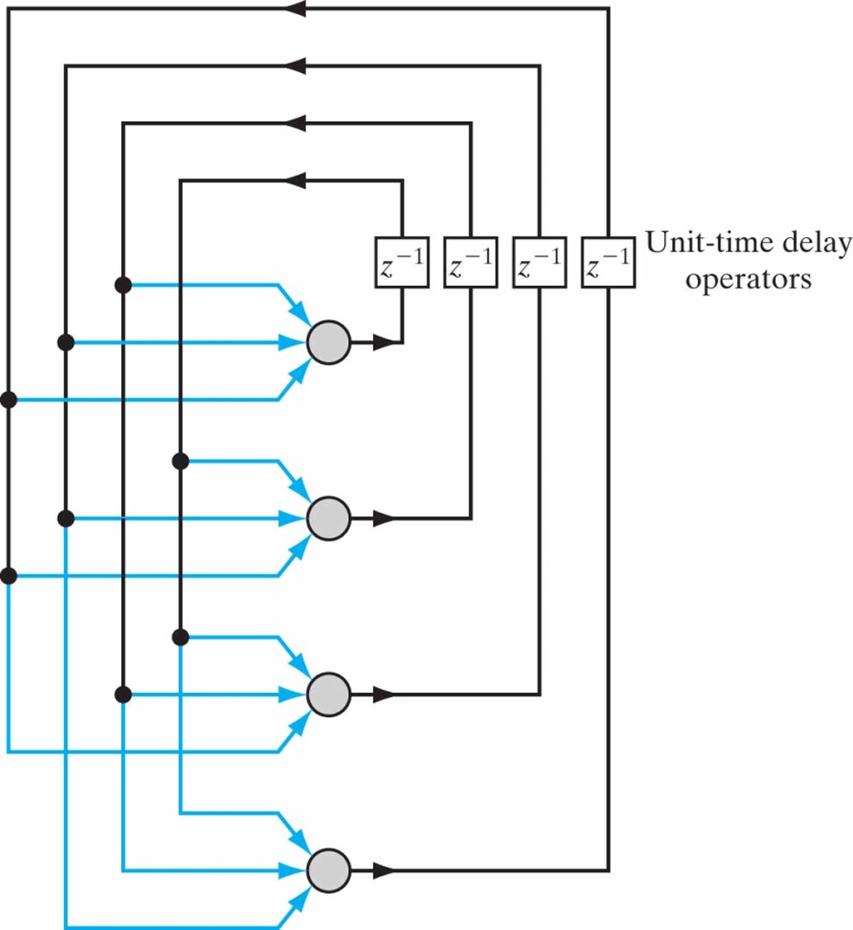
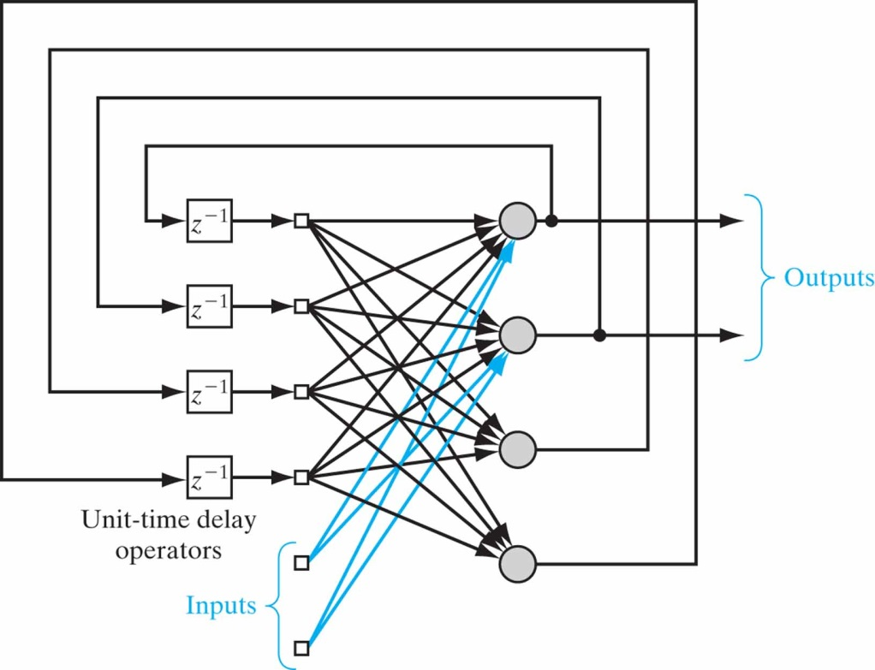
Recurrent Networks
A recurrent network has at least one feedback loop

Slide 15
Knowledge Representation
Knowledge of the world consists of two kinds of information
The known world state (prior information)
Observations (measurements) of the world. Examples used to train an ANN are drawn from such observations.
Examples can be labeled (each input is paired with a desired response) or unlabeled (only input signal).
A set of labeled examples can be our training data (or training samples)
E.g., A set of handwritten digit images and corresponding digit labels

Slide 16
Knowledge Representation
Four commonsense rules for knowledge representation
Similar inputs from similar classes should usually produce similar representations inside the network
Items from separate classes should be given different representations
If a feature is important, then there should be a large number of neurons involved in its representation
In radar, target detection in clutter example, detection performance is measured in 2 ways: Detection success and false alarm probability
Prior information and invariances should be built into the ANN design (specialized structure). This is good because:
Biological networks are very specialized
Specialized structure means less free parameters (learns faster and better)
Better network throughput
Building cost is reduced

Slide 17
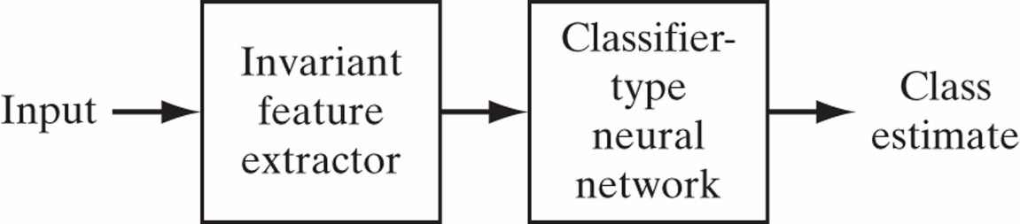
Knowledge Representation
Building prior information into ANN design
No well-defined rules to do this, but 2 techniques generally work
Restrict the network to use local connections (receptive fields)
Weight-sharing (again free parameters are reduced as a side effect) (the ANN on next page)
Building invariances into ANN design
E.g., Rotated versions of same handwritten letter or same word spoken soft/loud/slowly/quickly
Invariance by structure
Invariance by training
Invariant feature space

Slide 18
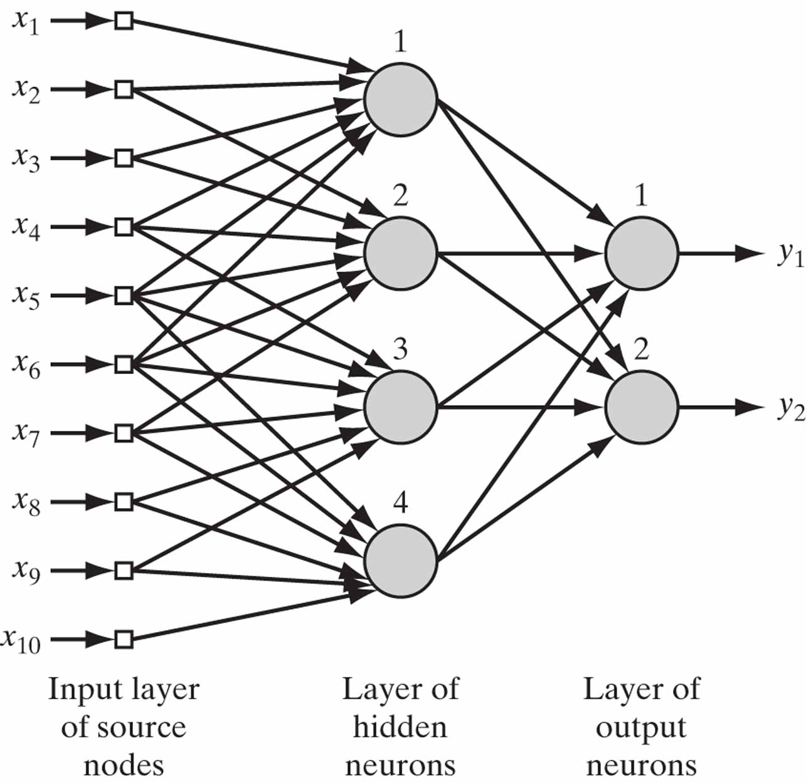
Figure 20 Illustrating the combined use of a receptive field and weight sharing. All four hidden neurons share the same set of weights exactly for their six synaptic connections.

